Slide 1
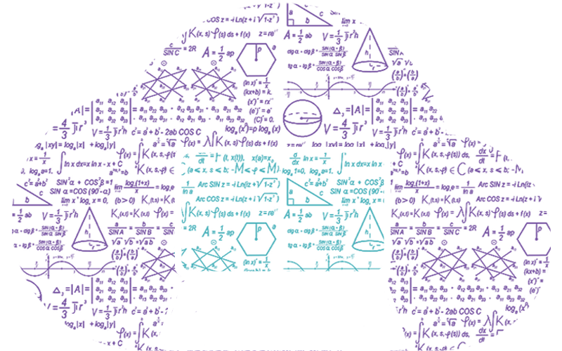
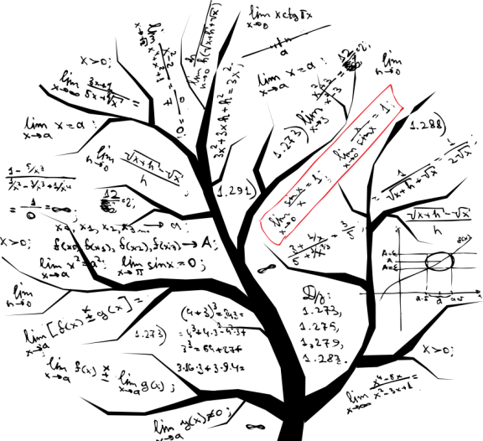
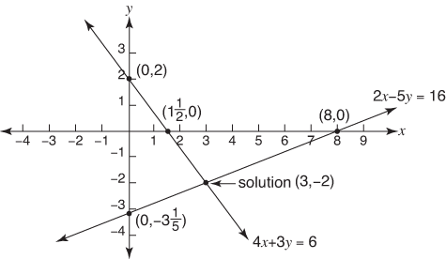


LINEAR EQUATIONS IN TWO VARIABLES
Devashree
Sopare
Shastami
Kichak
Shrustee
Khelkar
Smit Khadatkar
Suhani Agnihotri
Sarvesh Hardas

Slide 2
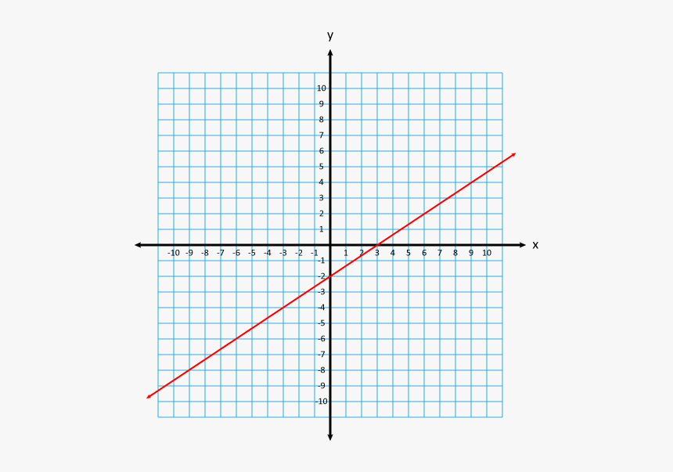
INDEX
1
Linear equation in one variable
2
Linear equation in two variable
3
Graph of linear equation
4
Linear equation parallel to x and y axis on graph
5
Lines passing through origin
6
Solutions of linear equation
7
Summary

Slide 3
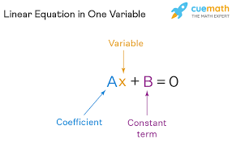
LINEAR EQUATION IN ONE VARIABLE
.

Slide 4
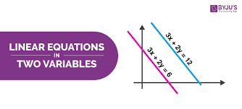
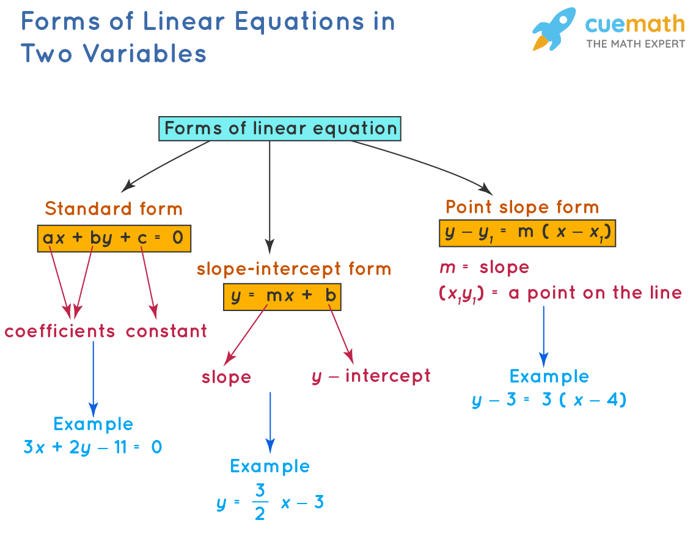
LINEAR EQUATIONS IN TWO VARIABLES
The linear equations in two variables are of the highest exponent order of 1 and have one, none, or infinitely many solutions.
The standard form of a two-variable linear equation is ax+ by+ c= 0 where x and y are the two variables.
The solutions can also be written in ordered pairs.
The graphical representation of the linear equations in two variables includes two straight lines which could be intersecting lines, parallel lines, or coincident lines.

Slide 5
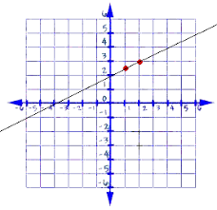
GRAPH OF LINEAR EQUATION

Slide 6
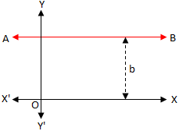
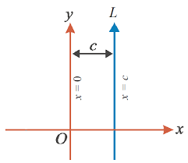
LINEAR EQUATION PARALLEL TO X & Y AXIS ON GRAPH
Equations of Line Parallel to X-axis | Equations of Line Parallel to Y-axis
We know that the equation of x-axis is y=0. Thus, the equation of line parallel to the x-axis is given by the equation: y = k. Where “k” is a constant value. The above equation is considered as the generalized form of line equation parallel to the x-axis. We can also say that “k” is a real number, and it is the distance from the x-axis to the line y=k. An example of a line equation parallel to the x-axis is y=5. It can also be written as y-5 =0. | The general form of the equation of y-axis is x = 0. Hence, the equation of line parallel to the y-axis is given by the equation: x = k. Where “k” is a constant value, which is a real number that represents the distance from the y-axis to the line x =k. The equation x = k is the generalized form of line equation parallel to y-axis. An example of an equation of line parallel to the y-axis x = 7, which can also be represented as x – 7 =0.

Slide 7
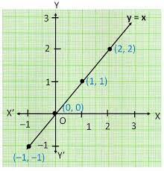
LINES PASSING THROUGH THE ORIGIN

Slide 8

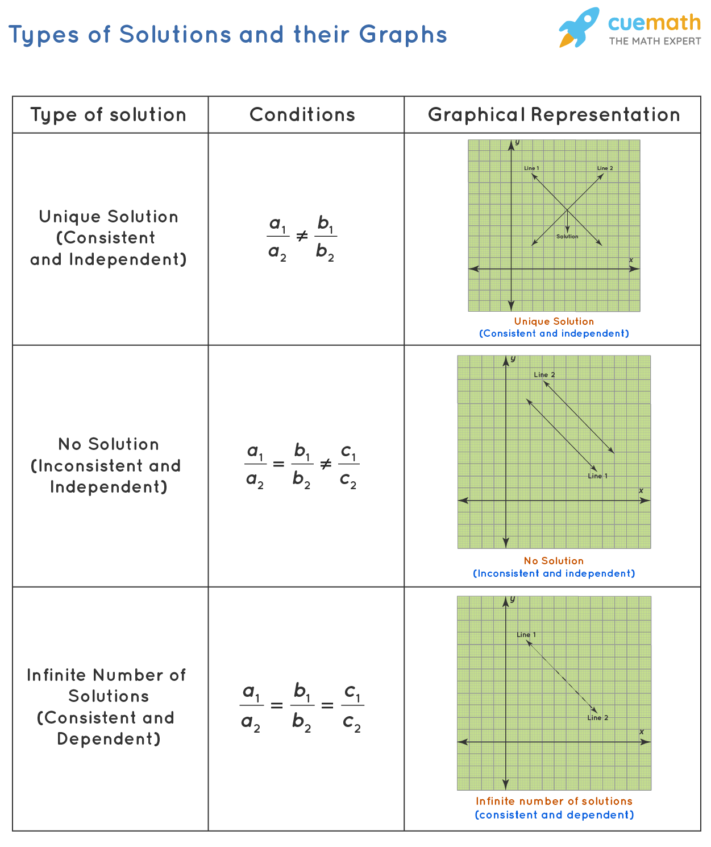
SOLUTIONS OF LINEAR EQUATIONS

Slide 9


